Slide 1
Level 4/5 Group 10
Courtney Pearson S185717 Aaron Kegge S186229 Thomas McCarthy S183168

Slide 2
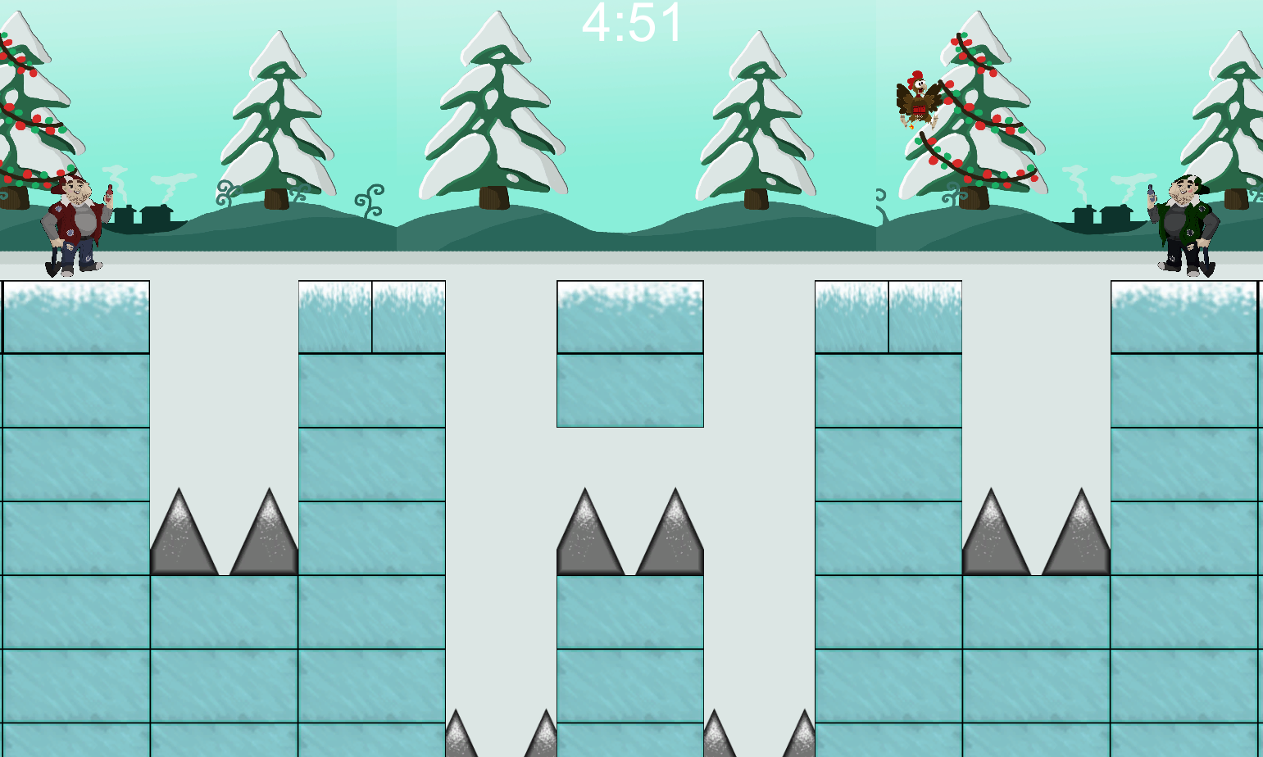
Genre/ Style
2D Platformer
Pc /Arcade Machine
Competitive 2 Players
CP

Slide 3
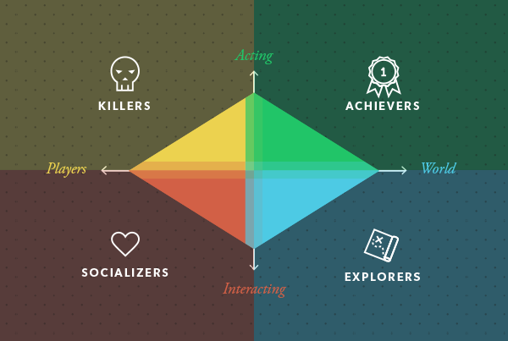
Target Demographic
Socializers+ Achievers
Age: 16+
Gender: Males and Females
T M

Slide 4
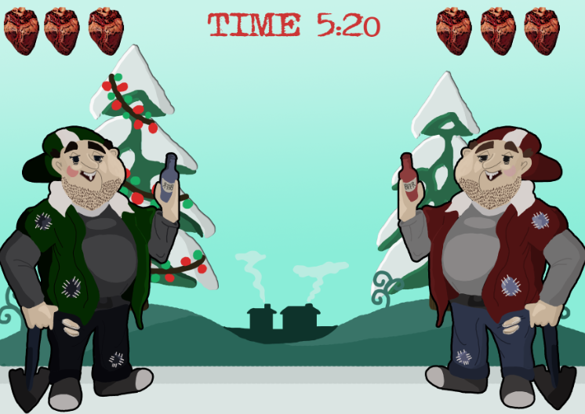
Visual Hierarchy
CP

Slide 5
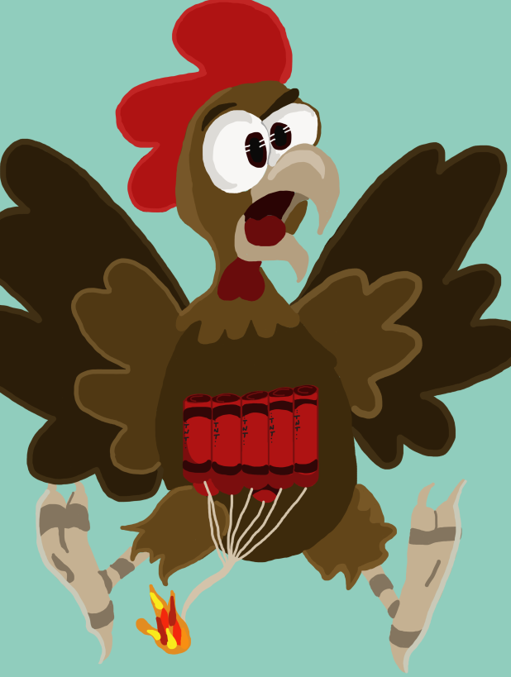
Physics
Gravity – Items falling Players can fall off the ice Items stun the players
Friction – Slippery Ice
ak

Slide 6
Mechanics
Symmetric mechanic - shovels / Attack
Damage ( Falling exploding chickens)
Timer
Wall Jumping / Double jumping
Health - Hearts
CP

Slide 7
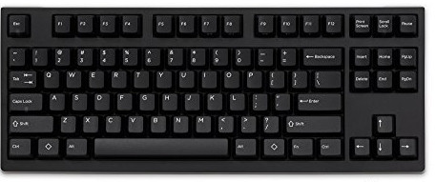
What does the player do?
Button Press
Competitive
Reflex – Avoid Damage
Triumph
TM

Slide 8
Play Testing Feedback
Controls – Confusion
Visual Hierarchy – Colours on old prototype
Gameplay- Dig under own player / Competitive
TM

Slide 9


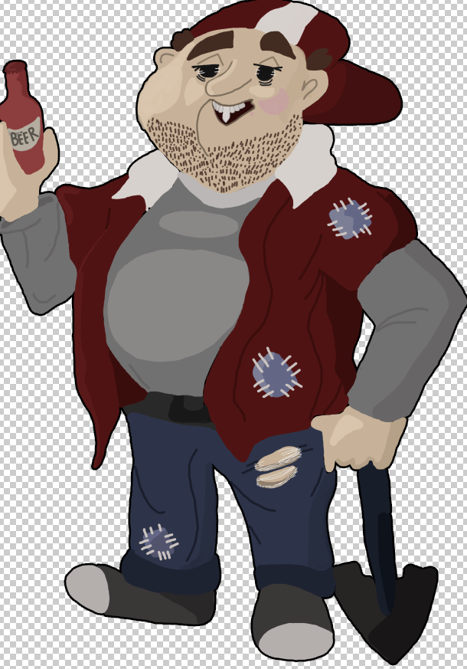
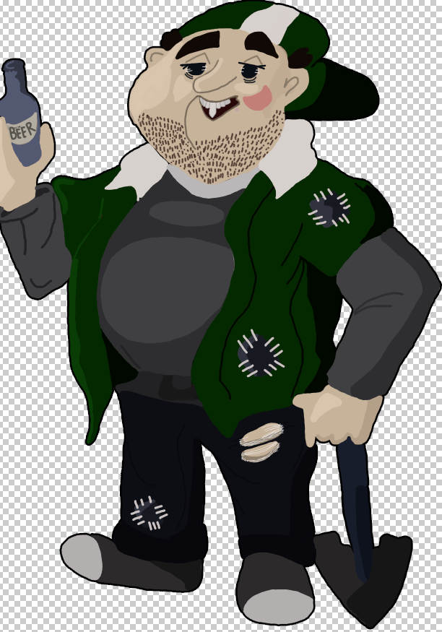

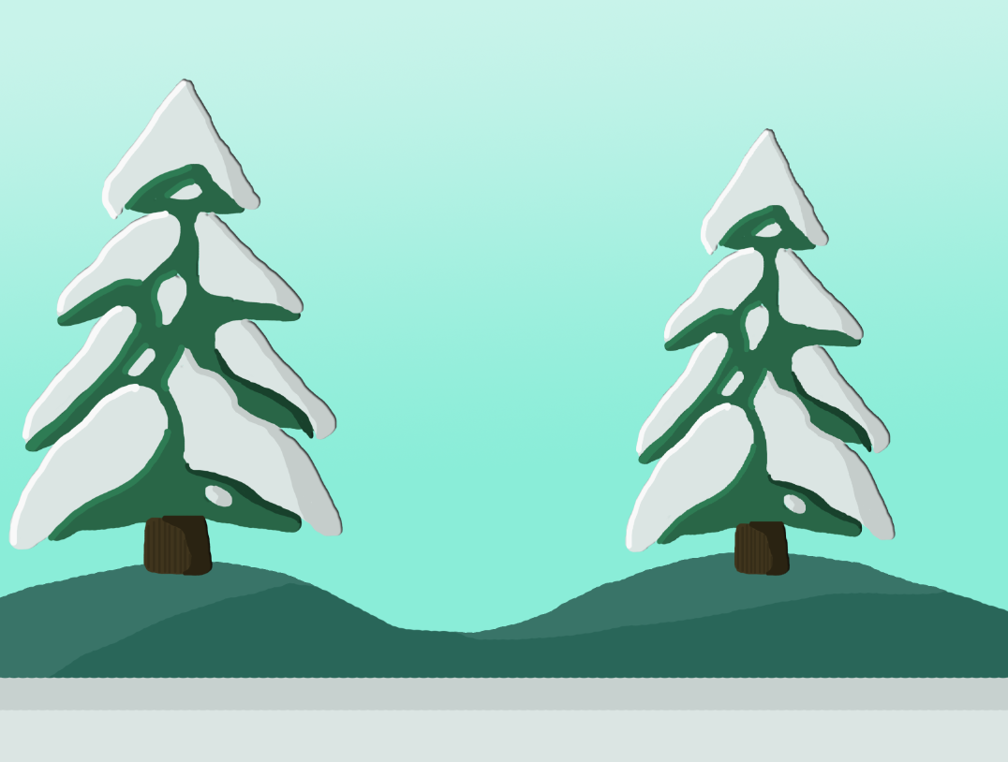
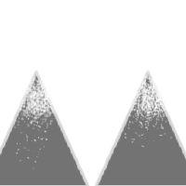


Art Assets
CP

Slide 10
Prototype
Ak

Slide 11
Any Questions?

